Slide 1
Compiler Construction Principles and Practice
How do computers understand and execute high-level languages?

Slide 2
About me
Courseware:
See later on Blackboard.
Email：
刘洪娟：liuhj@swc.neu.edu.cn
Office：
信息B444

Slide 3
About the score
课堂测验10%
课后作业20%
实验验收和报告30%
期末大作业报告40%

Slide 4
Reference books
教材：
  英文版：（美）Kenneth C. Louden著，《编译原理与实践》（英文版），机械工业出版社，2012-8。
  中文版：冯博琴等译，《编译原理与实践》，机械工业出版社，2002-2。
参考书：
  胡伦骏等：《编译原理》（第2版），电子工业出版社 , 2005-7。----简单
  （美）Alfred V.Aho, Ravi Sethi Jeffrey, D. Ullman著，李建中，姜守旭译：《编译原理》，机械工业出版社，2003-1。----龙书
  陈火旺等，《程序设计语言编译原理》（第3版）， 国防工业出版社，2003-2。----国内经典

Slide 5
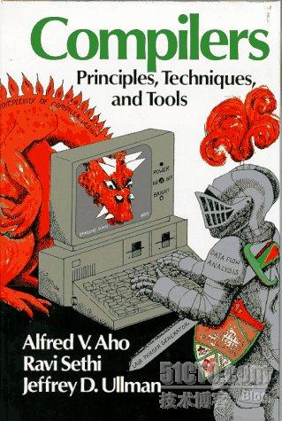
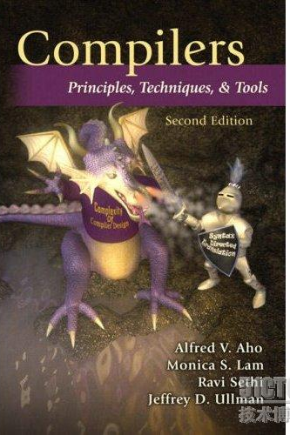
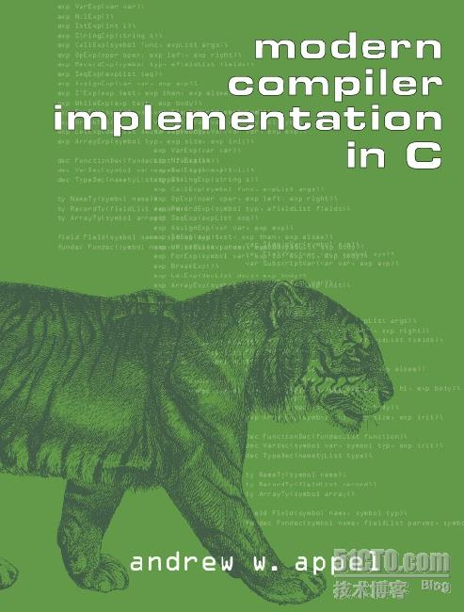
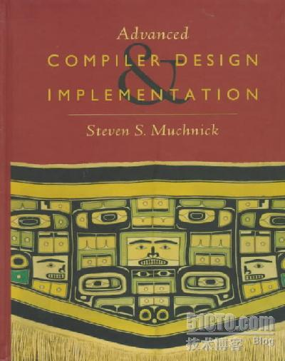
龙书、虎书和鲸书
1986
2006
1997

Slide 6
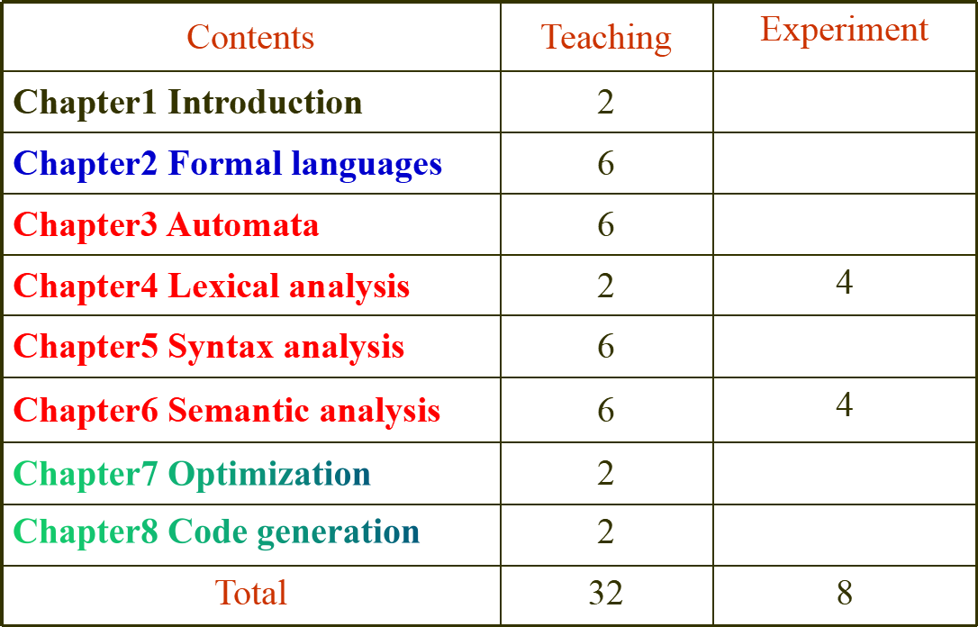
Period Distribution（40 periods）

Slide 7
本课程在计算机系统中的地位
电子技术
电路原理
大学物理
组成原理
数字逻辑电路
硬件
体系结构
计算机网络
通讯概论
安全与保密
接口与通讯技术
汇编语言
程序设计语言
计算机系统
C、C＋＋、JAVA、Python、Perl…
高级语言
编译器
计算理论
系统软件
操作系统
DOS、Windows 、UNIX…
数据库
Access、Sybase 、Oracle…
软件
数据结构
应用软件开发
软件工程
算法设计与分析
人工智能

Slide 8
课程的名称、地位和特点
课程名称：编译理论、编译原理、编译结构、编译技术和编译方法等。
课程地位：编译程序（系统）和操作系统一起构成了计算机中两大系统软件；一个是计算机资源的操纵者；而另一个是计算机软件资源的开拓者。
课程特点:
知识性— 形式语言和自动机作为本课程的两大理论基础并具有典型的应用技术;
系统性— 从词法、语法、语义直到目标生成，构成了语言翻译的完整体系;
趣味性— 关于语言处理的一些经典算法和实现技术，可以享受获取软件设计方法的乐趣。
应用性— 编译技术可广泛应用于文本编辑、排版系统、模式识别以及机器翻译等各个领域。

Slide 9
Chapter1 Introduction
Summary
1.1 Why we need compilers?
1.2 Logic structure of compilers
1.3 Example for compiling process
1.4 Implementation of compilers
1.5 Building of compilers

Slide 10
1.1 Why we need compilers?
Ⅰ.
high-level language 1
transformation
high-level language 2
interpreter
compiler 2
compiler 1
decompile
Ⅱ.
assembly language
assembler
disassemble
Ⅲ.
machine language
Fig. 1.1 The system of computer languages

Slide 11
1.1 Why we need compilers?
A compiler is a translator, which can translate a program written in a high-level language to an equivalent program written in a low-level language.
The execution process of compiler
data
source language
compiler
object language
executor
result
phase of compilation
phase of execution
Fig. 1.2 The execution process of compiler

Slide 12
1.1 Why we need compilers?
An interpreter is also a translator, whenever a statement is interpreted and then is executed by computer without object code.
data
Source statement
Interpreter
result
Fig. 1.3 The execution process of interpreter
  Difference between compiler and interpreter
(1) The former produces object codes;
(2) The former have high efficiency and the latter is convenient for man-machine conversation.

Slide 13
1.2 Logic structure of compilers
Source code
Intermediate code
Scanner
Code optimizer
Error handler
Tokens
Optimized intermediate code
Parser
Symbol Table
Syntax tree
Code generator
Semanticanalyzer
Object code
Intermediate code
Front end
Back end

Slide 14
※ Analogy between compiler and English translation
1.2 Logic structure of compilers
I wish you success!
Scanner – identify words, ensure the class of
words
Parser – identify grammar structure of
phrase and sentence patterns.
Semantic analyzer – ensure semantic features
of words, phrases and sentence patterns;
Code optimizer – edit text；
Code generator – make translation.

Slide 15
1.3 Example for compiling process
Example 1.1: A segment of C program :
int a1, b;
. . .
b=a1+2*5;
Compiling process
type code
1. Scanner: identifies and classifies the token
⑴ keyword (k) -- int
⑵ identifier (i) -- a1, b
⑶ const (c) -- 2, 5
⑷ delimiter (p) -- , ; = + *

Slide 16
2. Parser: determines the structure of the program
1.3 Example for compiling process
The parsing process of b = a + 2 * 5 :
<assignment>
The hierarchy of an expression
<var> = <expression>
b
<term> + <term>
Ⅰ
<factor>
<factor> * <factor>
Ⅱ
<var>
<const>
<const>
Ⅲ
a
2
5
Fig. 1.4 The parsing syntax tree of b=a+2*5

Slide 17
3. Semantic analyzer：analyze the meaning of the structure
1.3 Example for compiling process
int a,b;
. . .
b=a+2*5;
Construct symbol table of identifier
Symbol table
The area of data
name
type
class
address
a
i
v
value of a
b
i
v
value of b
Construct the semantic tree (intermediate code)
b = a+2*5
=
or
(1) ( * 2 5 t1 )
(2) ( + a t1 t2 )
(3) ( = t2 _ b )
b
+
a
*
2
5

Slide 18
4. Code optimizer: improves the quality of codes
1.3 Example for compiling process
b = a+2*5
After constant combination, optimized codes are as follows:
=
(1) ( * 2 5 t1 )
(2) ( + a t1 t2 )
(3) ( = t2 _ b )
b
+
a
*
2
5
=
(1) ( + a 10 t2 )
(2) ( = t2 _ b )
b
+
a
10

Slide 19
5. Code generator
1.3 Example for compiling process
The generated object code for the example：
(1) ( + a 10 t2 )
(2) ( = t2 _ b )
① LD R,10
② ADD R, a
③ ST R, b
R is a register.
Three statements are：LOAD, ADD and STORE.

Slide 20
1.4 Implementation of compilers
Passes: The times that compiler scans the source programs or equivalent programs.
Most compilers use more than one pass. A typical arrangement is:
1. Scanning, parsing and semantic analysis in the first pass.
2. Code optimization and code generation in the second pass.
The phases in one pass intercross with each other, e.g.
Return a token
2
Semantic
analyzer
Scanner
Parser
1
3
Main program
Request a token
Generate intermediate code

Slide 21
1.5 Building of compilers
Three languages involved in compilers: a source language, a object language and an implementation language.
The building of compilers:
The existing programming language
Self-compiling
Transplanting: rewrite the back end of compiler
Build compilers automatically：
Scanner builder: LEX
Parser builder: YACC
Compiler builder
Input: Lexical rules, syntax rules and semantic explanation.

